Slide 1
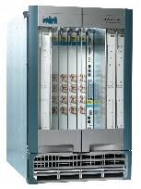
CS 118: IP Addressing and Forwarding
George Varghese

Slide 2
Copy File F at S
to File F at D
S
R1
R2
D
User Interface
Write (m) to connection queue
Read (m)
Transport (TCP)
Interface
^{F}6-8 | ^{F}2-5 | F₁
Send (segment) to D
Now here
Receive (segment)
Routing (IP) Interface
S
R1
R2
D
other paths?
Send (packet)
Receive (packet)
Data Link Interface
R1
R2
Been there, done that
Send (bit)
Receive (bit)
Physical Layer Interface
Been there, done that
RECALL THE IP ABSTRACTIONS:

Slide 3
Source
Router
Destination
application
presentation
session (null)
transport
network
data link
physical
AH
application
presentation
session (null)
transport
network
data link
physical
AH
AH
AH
AH
AH
TH AH
TH AH
NH TH AH
NH TH AH
DH NH TH AH
DH NH TH AH
DH NH TH AH
DH NH TH AH
NH TH AH
network
data link
physical
NH TH AH
DH NH TH AH
DH NH TH AH
DH NH TH AH
DH NH TH AH
HEADERS: WATCH HOW THEY ARE ADDED AND REMOVED. STRICT LAYERING – THE DEFINITION

Slide 4
TOPOLOGY
Sprint BBN
NAPs
Backbones
MCI
StarNet
Barrnet
Regionals
Stanford
Berkeley
Domains
DECNET
cs
Campus LANs
Your Laptop
Terminology: ISPs, POPs, Autonomous Systems, NAPs, Peering

Slide 5
Basic Internetworking in IP
Goal from start Unlike DECNET, SNA etc. starts with a hierarchy of physical networks with network specific routing that IP does not care about, to create an Internetwork of physical networks
IP ‘s role to route packets to the right physical network based on the network number. Offers a so-called datagram service with possible fragmentation and reassembly to deal with different maximum packet sizes
Error messages companion protocol called ICMP for error messages (header checksum failed, maximum time exceeded, redirect etc.).

Slide 6
IP Evolution
ARPANET started by linking government and university sites (including UCLA) in the 1970s
NSFNet in 1983 ARPANET splits up into MILNET and ARPANET. In 1984 NSF establishes NSFNET to be backbone. Campuses attached to backbone via regional networks (NYSERNET etc.) Strict hierarchy breaks down because of direct connections between providers
Multiple Providers by lat 1980s Internet becomes worldwide. From a research network to production quality. Multiple autonomous providers that need to work toi=gether

Slide 7
Names and Address
Names when you send to a domain name like cs.Berkeley.edu , a resolver is your host translates the name to a 32-bit IP address. All messages carry IP destinations addresses
Domain Name Service the translation is done using the so-called Domain Name Service or DNS which we will study later

Slide 8
ORIGINAL IP ADDRESSES: CLASSFUL
1
3
0
Net
Host
Class A
2
2
10
Net
Host
Class B
3
1
110 Net
Host
Class C
Original Model: Small number of large networks (class A), moderate number of campus networks, large number of LANs
Idea: Hierarchical address with a moverable boundary

Slide 9
Old IP Forwarding
Find Destination extract Network Number of destination address by parsing and checking for class A, class B etc,
Final hop reached? If (Network Number of Dest = Network number of one of this router’s local interfaces) deliver packet. Map to local address using ARP or some such network specific protocol
Lookup Router Table Lookup Network Number in the corresponding routing table, If it exists, deliver packet to corresponding NextHop.
Lookup Router Table: If no route entry exists, send to default router. (This looks silly but is a great way to avoid keeping lots of table entries in stub organizations like UCLA).

Slide 10
Challenge-Response
One level of hierarchy good but IP quickly ran into two scaling challenges:
Inefficient address usage: any organization that needed more than 255 addresses asked for a class B address (64,000) and they quickly ran out
Routing Table Growth: the response to no more class B addresses was to assign multiple Class C addresses. But now every backbone router needed to know more addresses, more routing traffic, search times etc.
Response changed IP forwarding to longest matching prefix. Why?

Slide 11
SUBNETTING AND SUPERNETTING
X.169.32
(24 bit)
X
cs = X.169
artsci = X.93
Wash U = X = 128.252. * .*
Subnetting a Class B address X
(19 bit)
Y
Y00000
Y11111
Supernetting Class C addresses Y0−Y31
Supernetting: Done recursively, leads to backbone routers only having hundreds of thousands of prefixes of lengths 8-32
Temporary Measures: Often today new organizations are give 1 IP address and use NAT. Need the move to IPV6 (128 bits)

Slide 12
IP evolved to meet challenges
Challenge 1 Interconnecting diverse networks → Net Numbers (Class A, 1 byte)
Challenge 2: Ethernets led to an explosion of networks → Hack to add Class B, Class C
Challenge 3 Class B addresses ran out → Give consecutive class C and use Longest Prefix Match
Challenge 4: Even Class C’s started running out → NAT and concurrent move to IP v6

Slide 13
New IP Forwarding
Lookup find longest matching prefix P of destination IP address in packet in forwarding table
Default or Local? If P is nil forward on default route. If the next hop associated with P is a local interfaces, deliver packet. Map to local address using ARP or some such network specific protocol
Send on its way if not, send packet to NextHop route associated with P
Backbone routers in default-free zone have to have many hundred thousand prefixes to reach everyone. Enterprise routers have 1000s because of heavy use of default routes.

Slide 14
ROUTER MODEL
ROUTER
B2
Message Switch (e.g.,bus,crosbar)
InputLink i
OutputLink 6
100100
B3
100100
Processor(s)
B1
Prefix Output
Link
01 *
100*
1
6
1* 2
Forwarding Table

Slide 15
FORWARDING AND ROUTING
IP ROUTING
(123.m)
x
A
(128.l)
C
R1
z
R2
128.*
B
(128.n)
R3
STEP 1: FIND NEIGHBORS
123.m−>P5
128.*−>P4
123.n−>P2
128.*−>P1
C
A
P4
P2 P1
P5
R2
R1
B
R3
STEP 2: COMPUTE ROUTES
C A
C A
C A z x
STEP 3: FORWARD

Slide 16
rest of network
FOUR PROBLEMS ENDNODES
MUST SOLVE
E4
R1
R2
E3
E1
E2
P1: Routers need Data Link Addresses of endnodes
P2: Endnodes need DL address of 1 router
P3: E1 and E2 should be able to communicate without a router
P4: E1 to E3 traffic should go through R2

Slide 17
IP Solutions to End-node Problems (see Worksheet 5)
P1: ARP for MAC address of destination
P2: a service called called DHCP gives you the IP address of one router (auto-configuration)
P3: two endnodes know they are on same subnet by comparing masks. Then ARP
P4: send to router and router sends redirect if packet returns on interface it entered router. (Ignore this code in project),

Slide 18
From theory to practice
1: Need to understand how to forward packets using longest matching prefix (linear search fine)
2: Need to understand how to implement ARP in your router
3: Need to understand how to implement ACLs using simple linear search
4: To implement all this and ACLs, you need to understand all the fields in an IP Packet including the TCP header (though we will do TCP later)

Slide 19
Basic Packet Formats
Ethernet Frame
Destination address | Source address | Type | Payload
Type: ARP or IPv4
ARP packet
Opcode | Src MAC address | Src IP address | Dst MAC address | Dst IP address | Payload
Opcode: ARP request or ARP reply
IPv4 packet
Version | … | TTL | Checksum | Src IP address | Dst IP address | Payload
ICMP packet
Type | Code | Checksum | Identifier | Seq Num | Payload
IPv4 header also contains header length, total length, ID,
flags, fragment offset, and protocol fields. ICMP not
Needed for this year’s project

Slide 20
ACLs refer to TCP Ports: Ports are like extensions
128.97.1.5
128.97.2.6
Port 3154
Port 21
Web Server
Browser
FTP
RESPONSE
Queue 3
Queue 4
TCP
Queue 1
Queue 2
TCP
Port 16581
Port 80

Slide 21
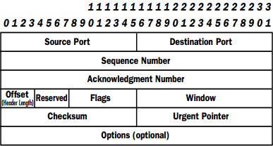
TCP Header: Where the Ports Lurk
For ACLs these are the only TCP fields that matter as they identify the application and so routers/firewalls use these fields for forwarding. Other fields we will understand when we do TCP

Slide 22
IP Forwarding (Data Plane)
Imaginary UCLA Topology
128.97.2.*
128.97.2.*
Core 1
128.97.2.*
EE
128.97.1*
CS
CS Router
EE Router
Core 2
128.97.2.6
EE Web Server
128.97.2.6
Your laptop
128.97.1.5
128.97.2.*
Notes:
Lets see the control versus data plane distinction in a simple picture. Assume that Engineering wants to send expenses to accounting and accounting is all addresses that start with 1.2., So the two routers on top have forwarding rules that route packets with such destinations addresses to the right. But now suppose the topmost link fails. In order to still get our expenses paid, we need some other protocol to change the forwarding rule at the upper left router to reroute packets via the bottom router. So informally, the data plane is the collection of . . . and the control plane s

Slide 23
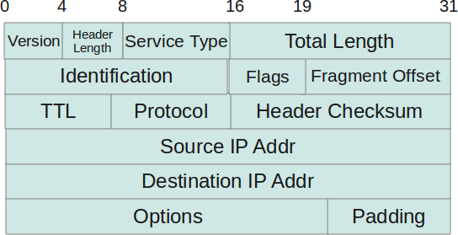
IP Header
We do longest match on the destination IP address: main field.
ACLs also check source IP address.
Also Protocol field and TTL

Slide 24
Controlling Forwarding with ACLS
128.97.2.*
128.97.2.*
Core 1
128.97.2.*
EE
128.97.1*
CS
CS Router
EE Router
Core 2
128.97.2.6
EE Web Server
128.97.2.6
Your laptop
128.97.1.5
Drop if Dest Port = 1433
128.97.2.*
A famous attack called Slammer targeted the SQL Port 1433. After that it is common to block this port
Notes:
Lets see the control versus data plane distinction in a simple picture. Assume that Engineering wants to send expenses to accounting and accounting is all addresses that start with 1.2., So the two routers on top have forwarding rules that route packets with such destinations addresses to the right. But now suppose the topmost link fails. In order to still get our expenses paid, we need some other protocol to change the forwarding rule at the upper left router to reroute packets via the bottom router. So informally, the data plane is the collection of . . . and the control plane s

Slide 25
Router Model with ACLs
Modified
Dest Port = 1433-> Drop
Input ACLs

Slide 26
ACL Syntax
Different for different vendors
Logically, a conjunction of predicates on IP and TCP fields and an action
For example, Dest IP = 129.97.* and Dest Port = 1433 → Drop
Most routers allow 100-1000 of them. When multiple match, first one wins (not longest as in Longest Prefix Match)

Slide 27
Forwarding Pseudocode: ARP
1. Find input network interface: findIfaceByName. Drop packet if interface is unknown
2. Read ethernet header and check the eth_type field. Ignore all but ARP and IPv4 types
3. If eth_type is ARP: a. If ARP Request packet: - Prepare and send ARP response packet b. If ARP Response packet: - record IP-MAC mapping information in ARP cache - send out all enqueued packets for ARP entry

Slide 28
Forwarding Code: IPv4
4. If eth_type is IPv4: - verify checksum, length, discard invalid packets - Check 5-tuple (IP dest, IP source, protocol, dest, source ports) in input ACL and drop if needed
5. Use the Longest Prefix Match algorithm to find a next-hop IP address in the routing table
6. Lookup ARP cache for MAC address mapped to the next hop destination IP address -- If valid entry found: forward packet - Else: queue received packet and send ARP request to discover the IP-MAC mapping.

Slide 29
ASIDE ON FRAGMENTATION AND REASSEMBLY
1
1500
R2
R
A
B
4500
4500
B A Id X 4000 bytes
X 0ffset 0
X Offset 1500 X
Last Offset 3000
Path MTU instead: Modern end-nodes find the right size (1500) instead of asking the routers to fragment. Fields ignored by most routers and in your project.

Slide 30
Digression on Fast IP Lookups

Slide 31
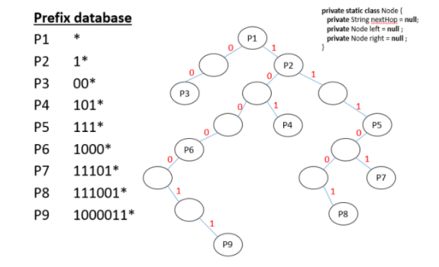
Approach 1: UNIBIT TRIE
https://raminaji.wordpress.com/unibit-tries/
32 STEPS IN WORST CASE. CONSIDERED TOO SLOW TODAY

Slide 32
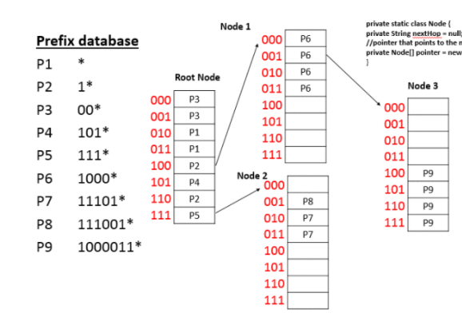
2: MULTIIBIT TRIE
https://raminaji.wordpress.com/unibit-tries/ (Srinivasan-Varghese CACM 98)
11 STEPS IN WORST CASE. SLOW AND TOO MUCH MEMORY

Slide 33
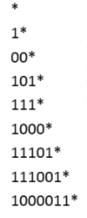
3: TERNARY CAM
Memory where each bit can be 0, 1, * that can be search in parallel
Broadcast
Pick
Longest
100000110
1 STEP IN WORST CASE. BUT TOO MUCH POWER AT HIGH SPEEDS

Slide 34
B1: IP Lookup State of the Art
Compressed Multibit Tries → Tree Bit map for Cisco CRS 1 at Terabits
CAMs for lower speed : → Ternary CAMs (Barefoot)
More details → Web site, Network Algorithmics text, my class

Slide 35

EPILOG: LABBERTON ON THE PINGED LIFE
Life through the the Internet contains and endless set of unsorted pings. These prompts demand our attention, and present us with a perpetual onslaught of distractions and diversions . . . Our lives can easily be the story of how we respond to this endless set of prompts
From Called, by Mark Labberton

